Slide 1
Resolution predicate
Albu Ioan

Slide 2
Exercise 2.1
Are the literals from the following pairs unifiable? If yes, find their most general unifier.
x, y, z ∈ Var
a, b ∈ Const
f, g ∈ F1
h ∈ F2
P ∈ P3

Slide 3
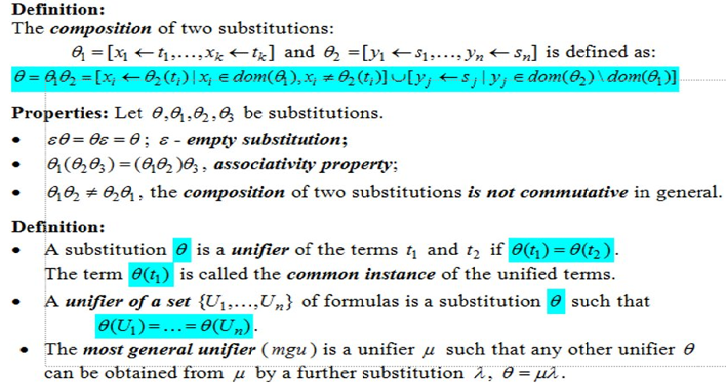

Slide 4
t1 = p(a, x, g(g(y))) t2 = P(Y,F(Z),F(Z))
⊖ = ε
⊖(t1) = P(a, x, g(g(y)))
⊖(t2) = P(y, f(z), f(z))

Slide 5
⊖(t1) = P(a, x, g(g(y))) ⊖(t2) = P(y, f(z), f(z))
Iteration 1:
Λ = [y <- a]
⊖ = ⊖lambda = [y ← a]
⊖(t1) = P(a, x, g(g(a)))
⊖(t2) = P(a, f(z), f(z))

Slide 6
⊖(t1) = P(a, x, g(g(a))) ⊖(t2) = P(a, f(z), f(z))
Iteration 2:
Λ = [x <- f(z)]
⊖ = ⊖lambda = [y <- a][x ← f(z)] = [y <- a, x <- f(z)]
⊖(t1) = P(a, f(z), g(g(a)))
⊖(t2) = P(a, f(z), f(z))

Slide 7
⊖(t1) = P(a, f(z), g(g(a))) ⊖(t2) = P(y, f(z), f(z))
Iteration 3:
The terms g(g(y)) and f(z) are not unifiable since none of them is a variable, therefore we can conclude that the literals t1 and t2 are not unifiable!

Slide 8
t1 = p(x, g(f(a)), f(x)) t2 = P(f(Y), Z, y)
⊖ = ε
⊖(t1) = P(x, g(f(a)), f(x))
⊖(t2) = P(f(y), z, y)

Slide 9
⊖(t1) = P(x, g(f(a)), f(x)) ⊖(t2) = P(f(y), z, y)
Iteration 1:
Λ = [x <- f(y)]
⊖ = ⊖lambda = [x ← f(y)]
⊖(t1) = P(f(y), g(f(a)), f(x))
⊖(t2) = P(f(y), z, y)

Slide 10
⊖(t1) = P(f(y), g(f(a)), f(x)) ⊖(t2) = P(f(y), z, y)
Iteration 2:
Λ = [z <- g(f(a))]
⊖ = ⊖lambda = [x <- f(y)][z <- g(f(a))] = [x <- f(y), z <- g(f(a))]
⊖(t1) = P(f(y), g(f(a)), f(f(y))
⊖(t2) = P(f(y), g(f(a)), y)

Slide 11
⊖(t1) = P(f(y), g(f(a)), f(f(y)) ⊖(t2) = P(f(y), g(f(a)), y)
Iteration 3:
Not unifiable because y is a subterm of f(f(y)).

Slide 12
t1 = p(a, x, g(g(y)) t2 = P(Z, h(z, u), g(u))
⊖ = ε
⊖(t1) = P(a, x, g(g(y))
⊖(t2) = P(z, h(z, u), g(u))

Slide 13
⊖(t1) = p(a, x, g(g(y)) ⊖(t2) = P(Z, h(z, u), g(u))
Iteration 1:
Λ = [a <- z]
⊖ = ⊖lambda = [a ← z]
⊖(t1) = P(a, x, g(g(y))
⊖(t2) = P(a, h(a, u), g(u))

Slide 14
⊖(t1) = p(a, x, g(g(y)) ⊖(t2) = P(a, h(a, u), g(u))
Iteration 2:
Λ = [x <- h(a, u)]
⊖ = ⊖lambda = [a ← z][x <- h(a, u)] = [a ← z, x <- h(a, u)]
⊖(t1) = P(a, h(a, u), g(g(y))
⊖(t2) = P(a, h(a, u), g(u))

Slide 15
Conclusion
The literals P(a, x, g(g(y))) and P(y, f(z), f(z)) are not unifiable.
The literals P(x, g(f(a)), f(x)) and P(f(y), z, y) are not unifiable.
The literals P(a, x, g(g(y)) and P(z, h(z, u), g(u)) are unifiable with the most general unifier mgu = [a ← z, x <- h(a, u), u <- g(y)]

Slide 16
⊖(t1) = p(a, h(a, u), g(g(y)) ⊖(t2) = P(a, h(a, u), g(u))
Iteration 3:
Λ = [u <- g(y)]
⊖ = ⊖lambda = [a ← z, x <- h(a, u)][u <- g(y)] = [a ← z, x <- h(a, u), u <- g(y)] = mgu(t1, t2)
⊖(t1) = P(a, h(a, g(y)), g(g(y))
⊖(t2) = P(a, h(a, g(y)), g(g(y))
⊖(t1) = ⊖(t2) => P(a, h(a, g(y)), g(g(y)) is the common instance of t1 and t2 => they are unifiable

